Slide 1
Emerging Threats to Financial Stability – New Challenges for the Next Decade
Brad Jones – Assistant Governor (Financial System), Reserve Bank of Australia
Australian Finance Industry Association Conference 31 October 2023, Sydney

Slide 2
Emerging Financial Stability Challenges for the Next Decade
‘Inside’ risks | ‘Outside’ risks
Fast deposit runs in the digital age | Geopolitics
Spillovers from institutions that are not systemically important | Operational risk
Higher interest rate volatility | Climate change

Slide 3
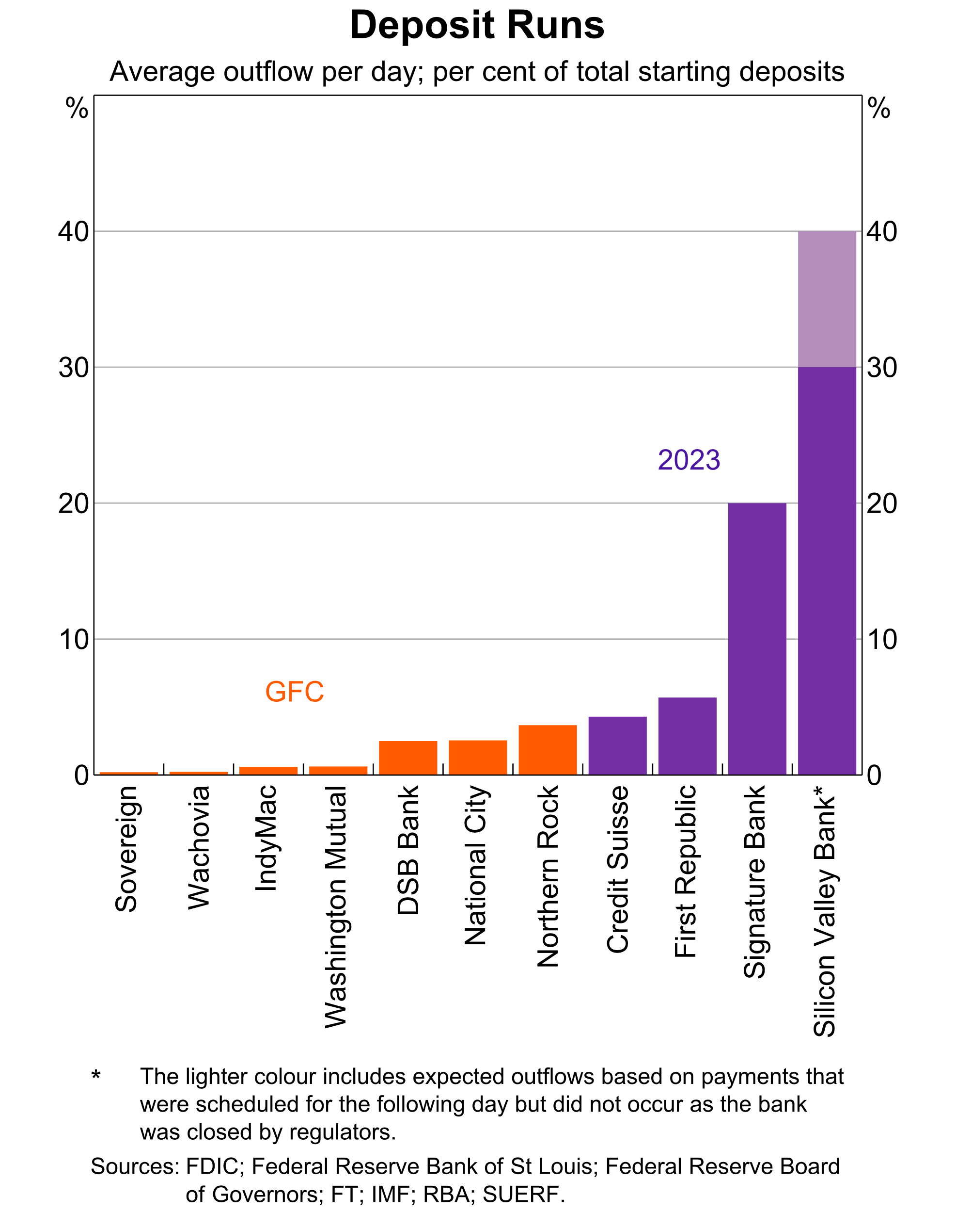

Slide 4
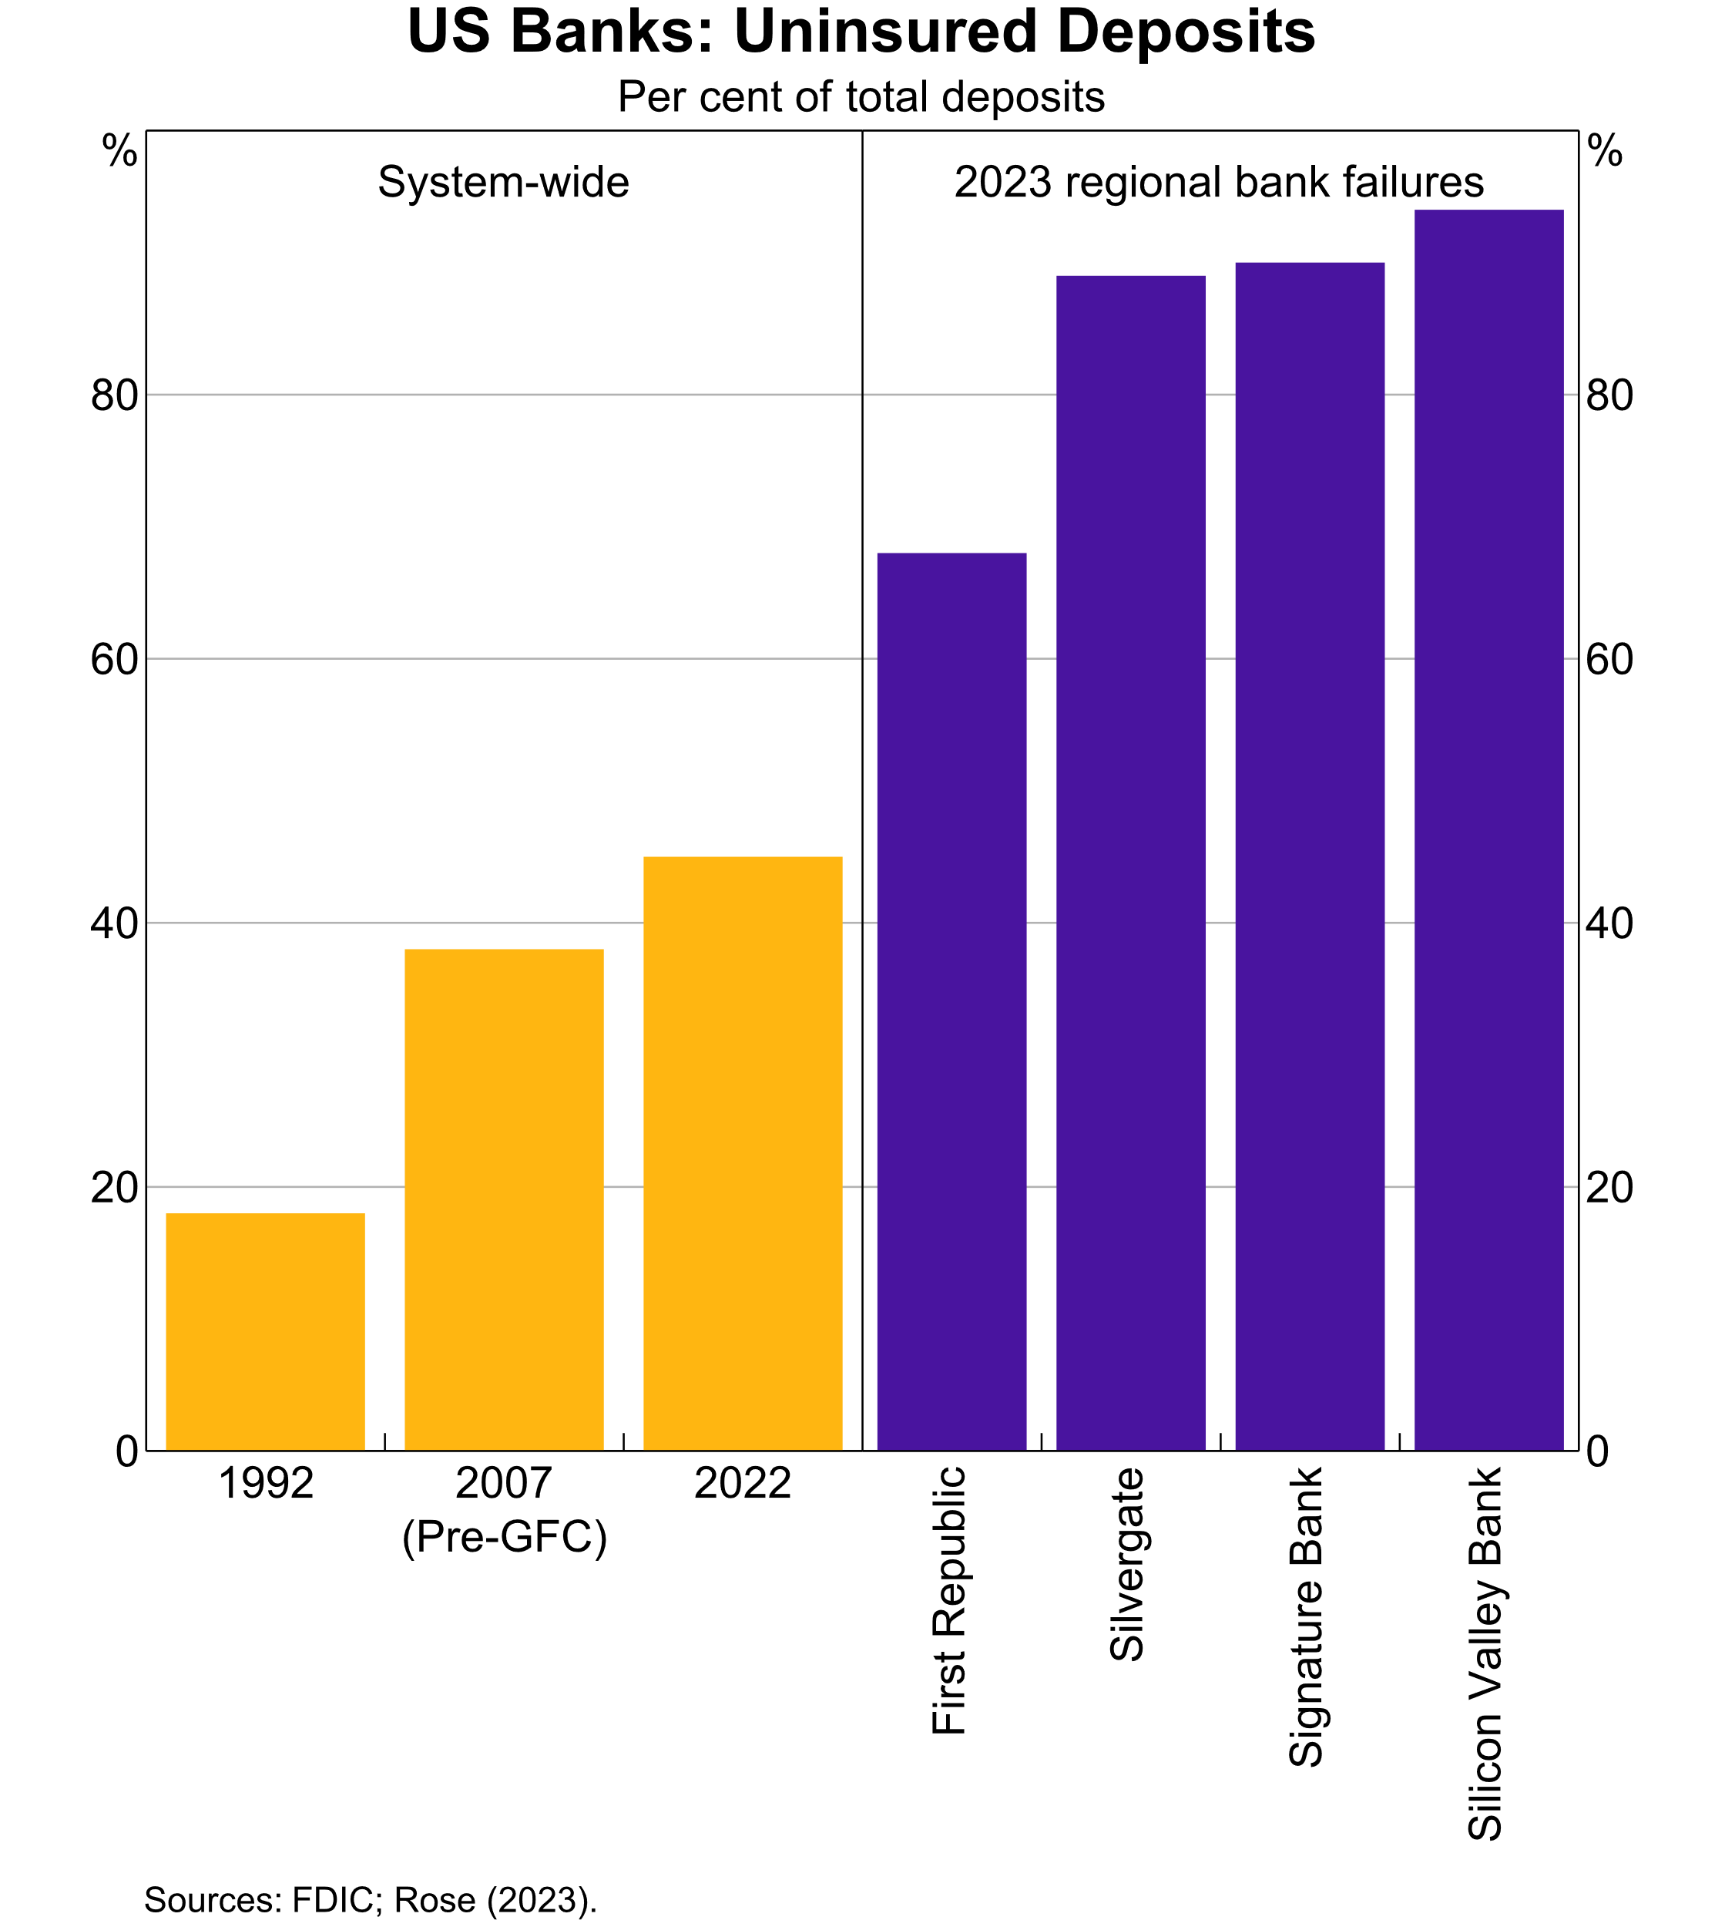

Slide 5
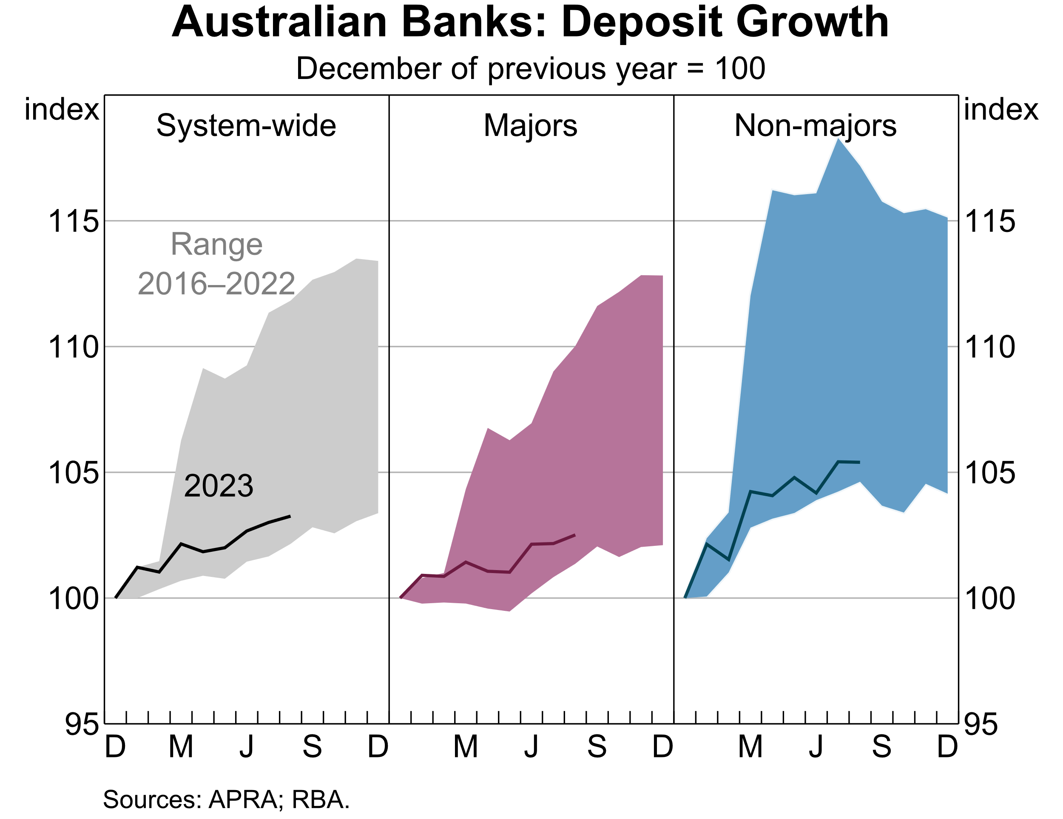

Slide 6
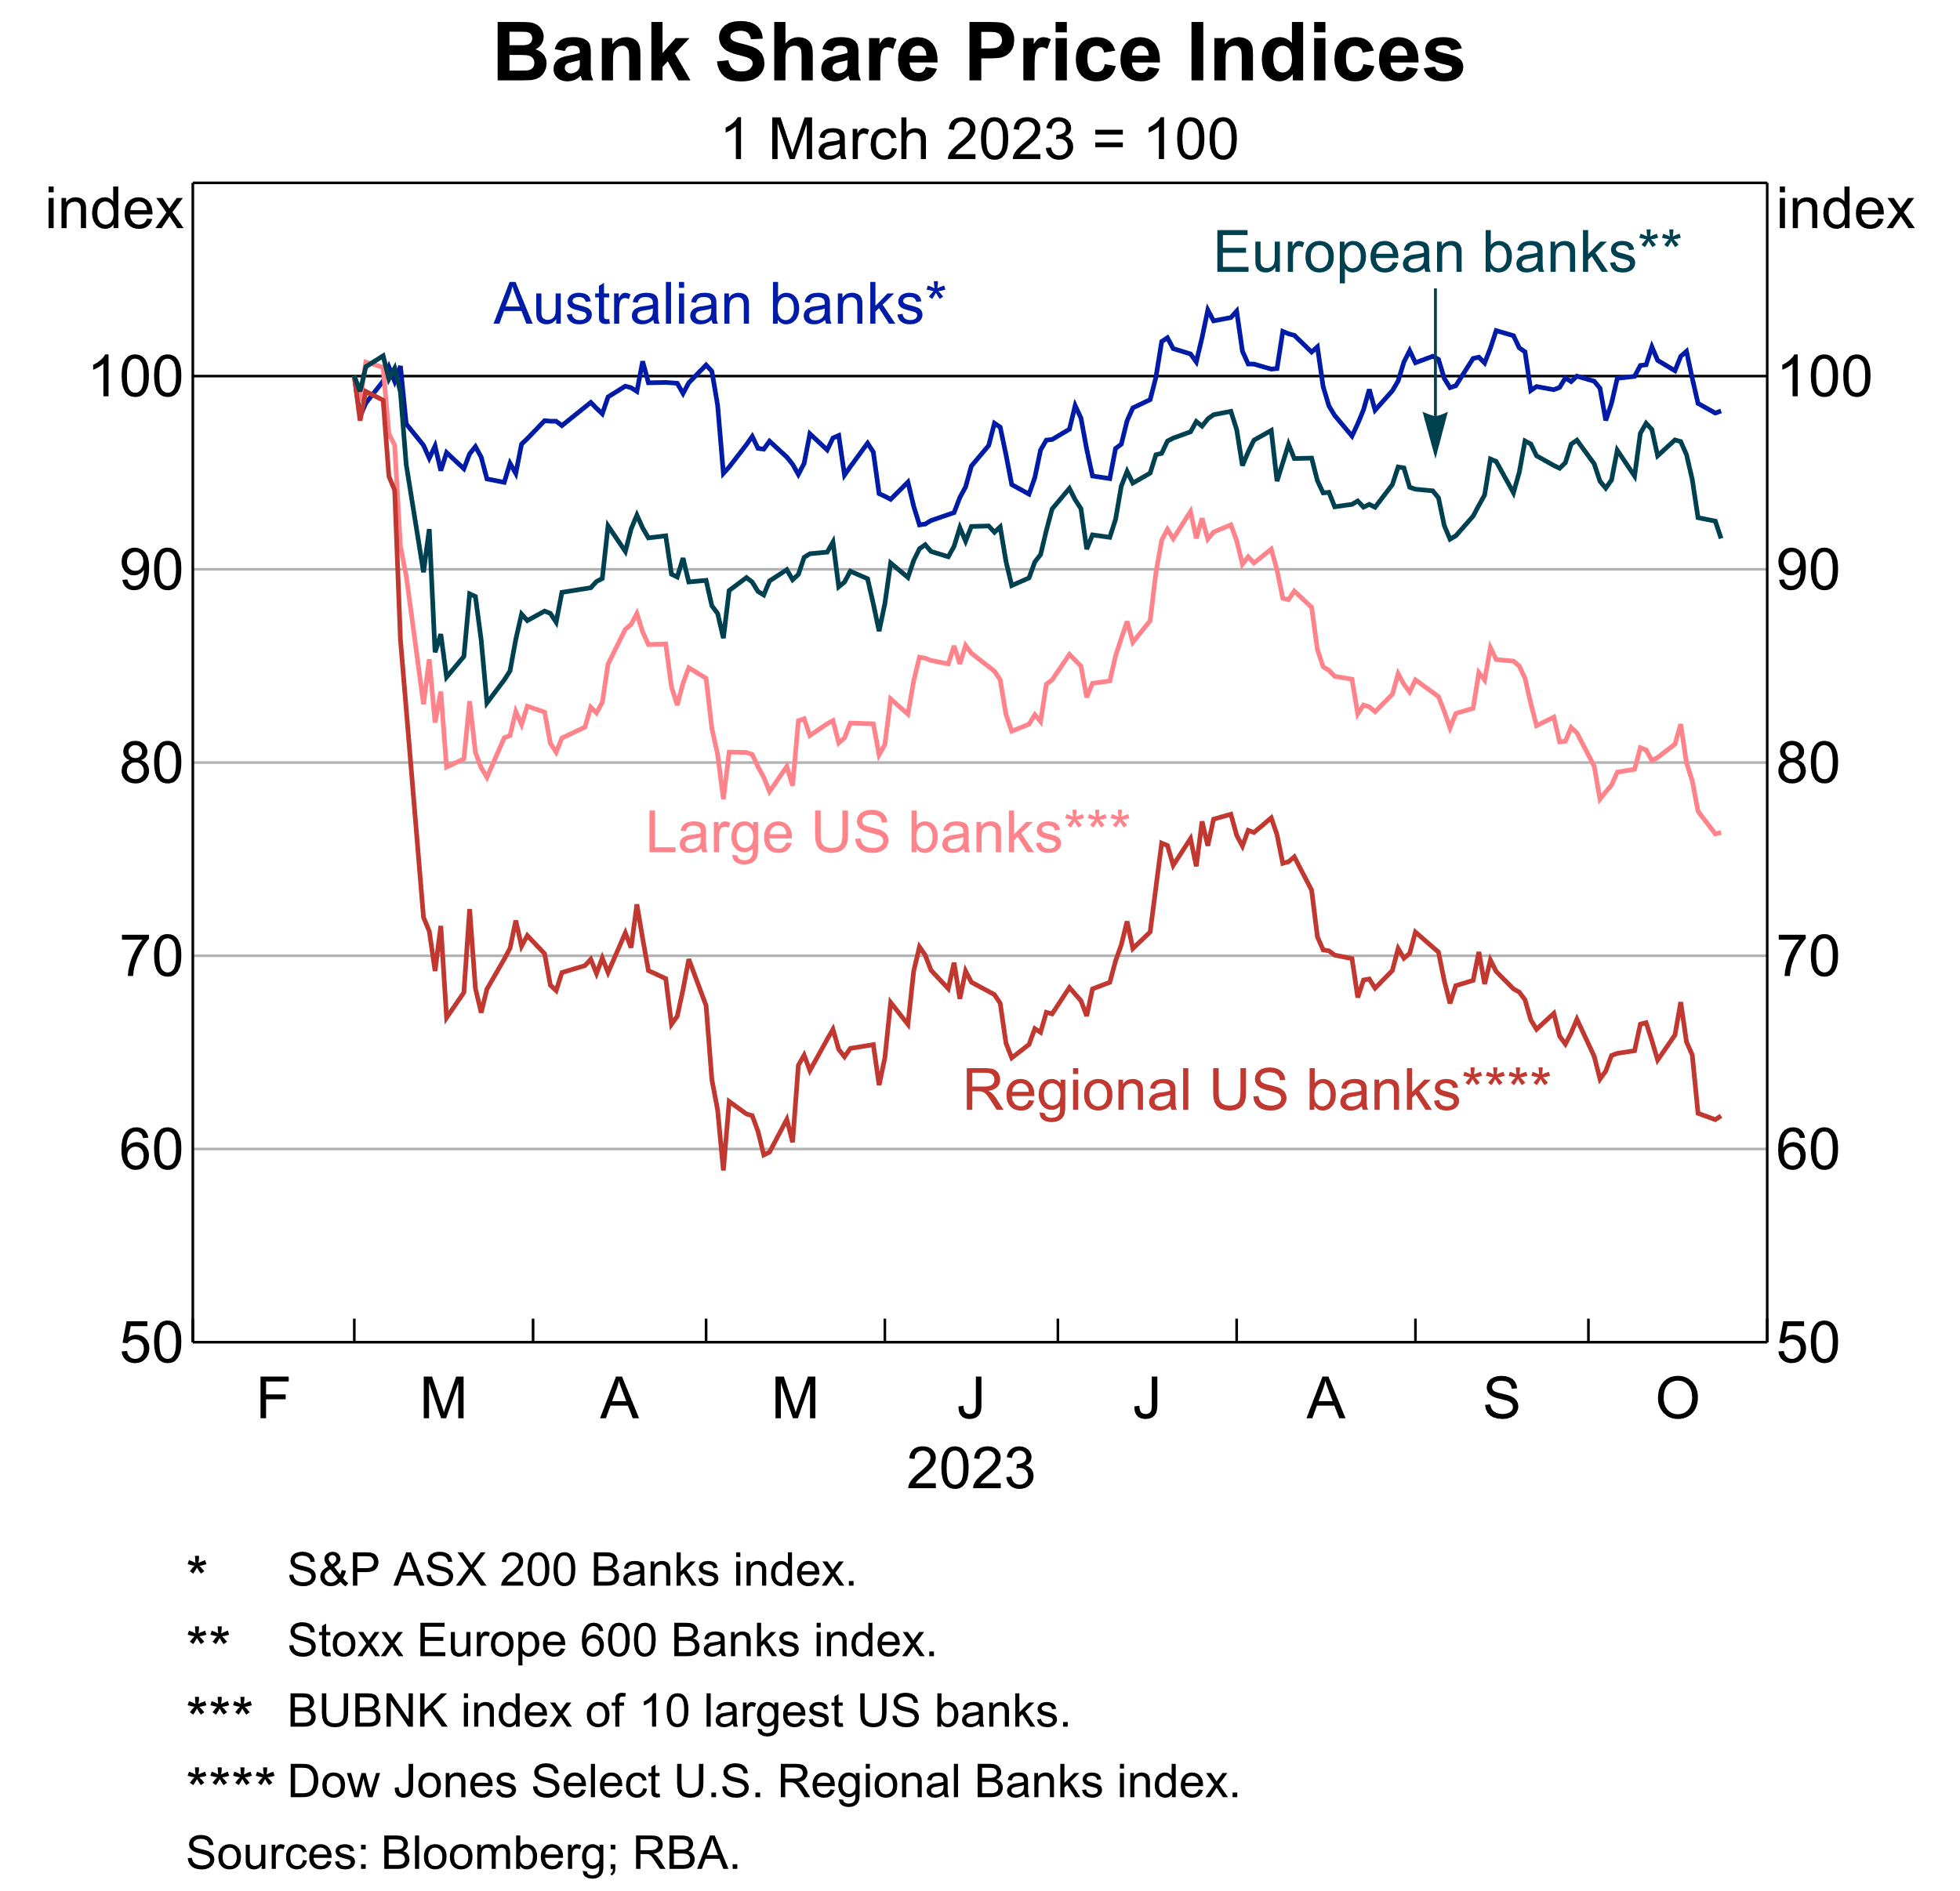

Slide 7
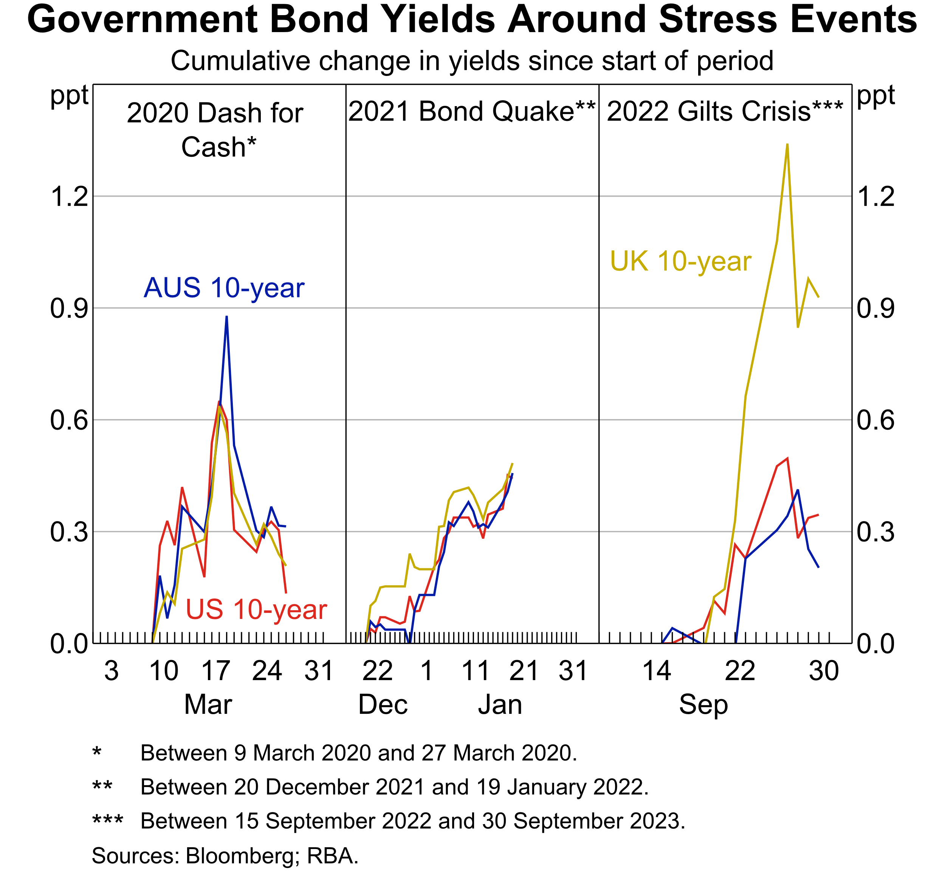

Slide 8
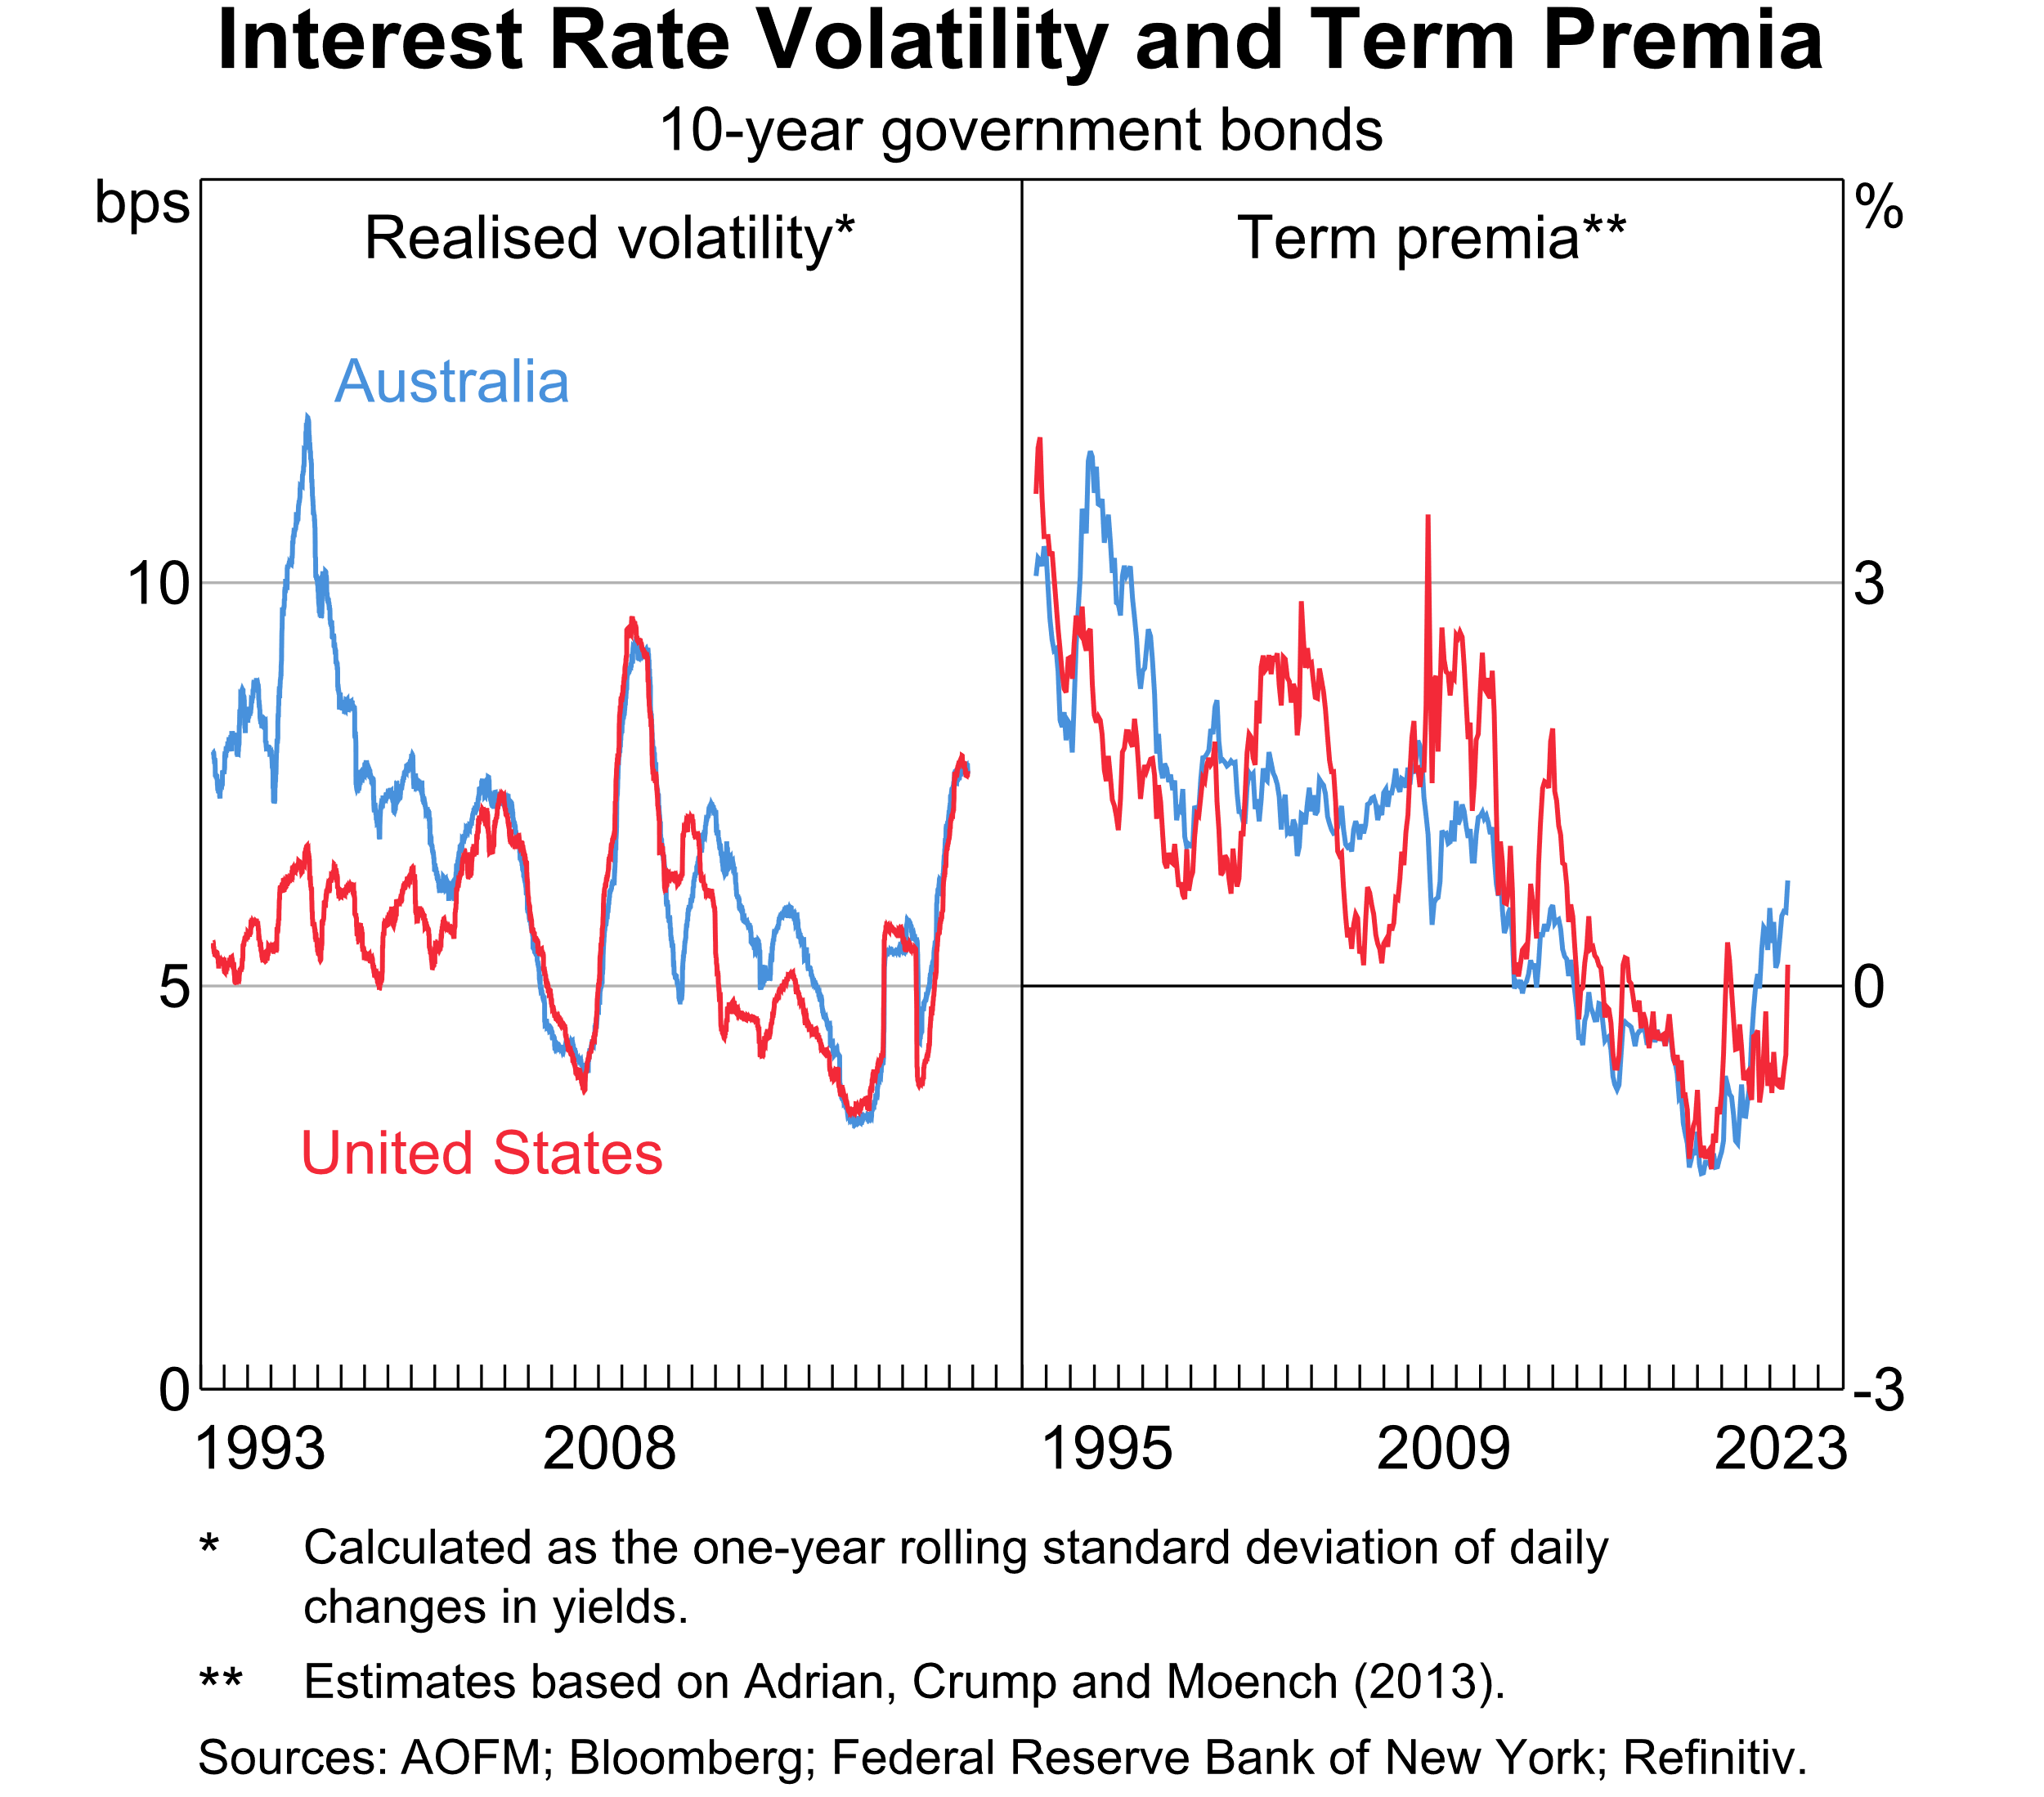

Slide 9
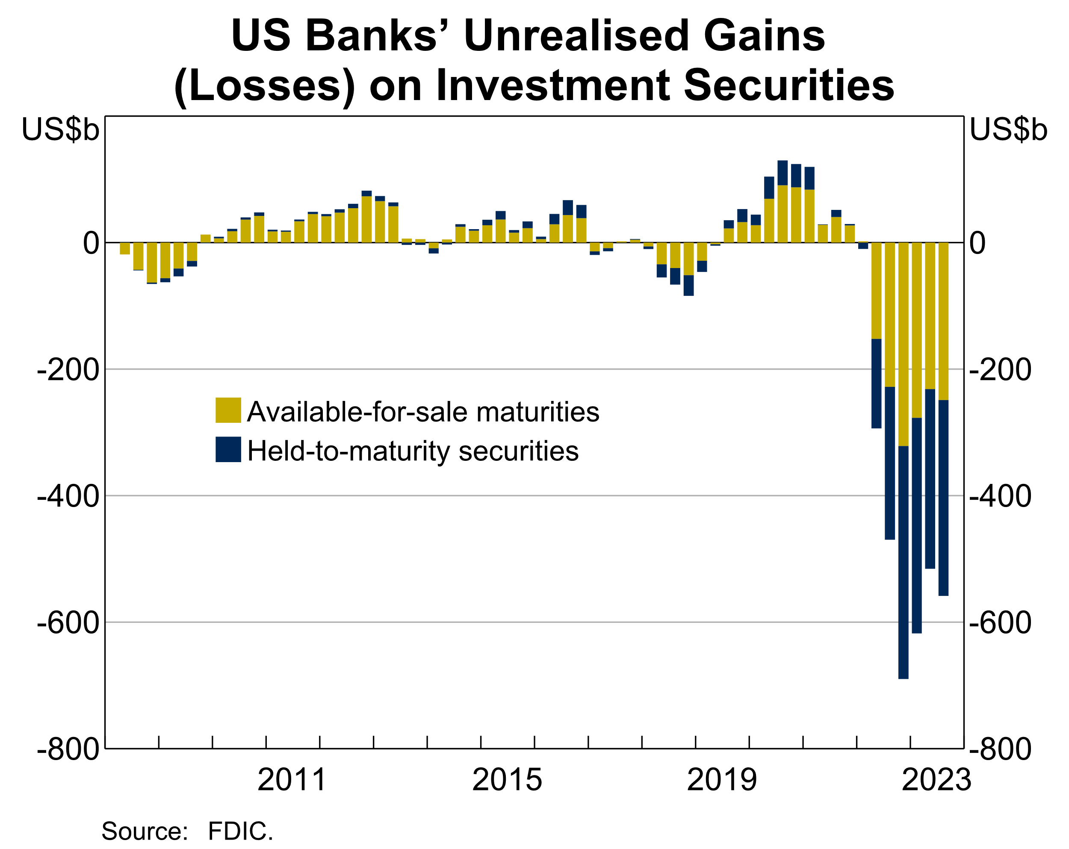

Slide 10
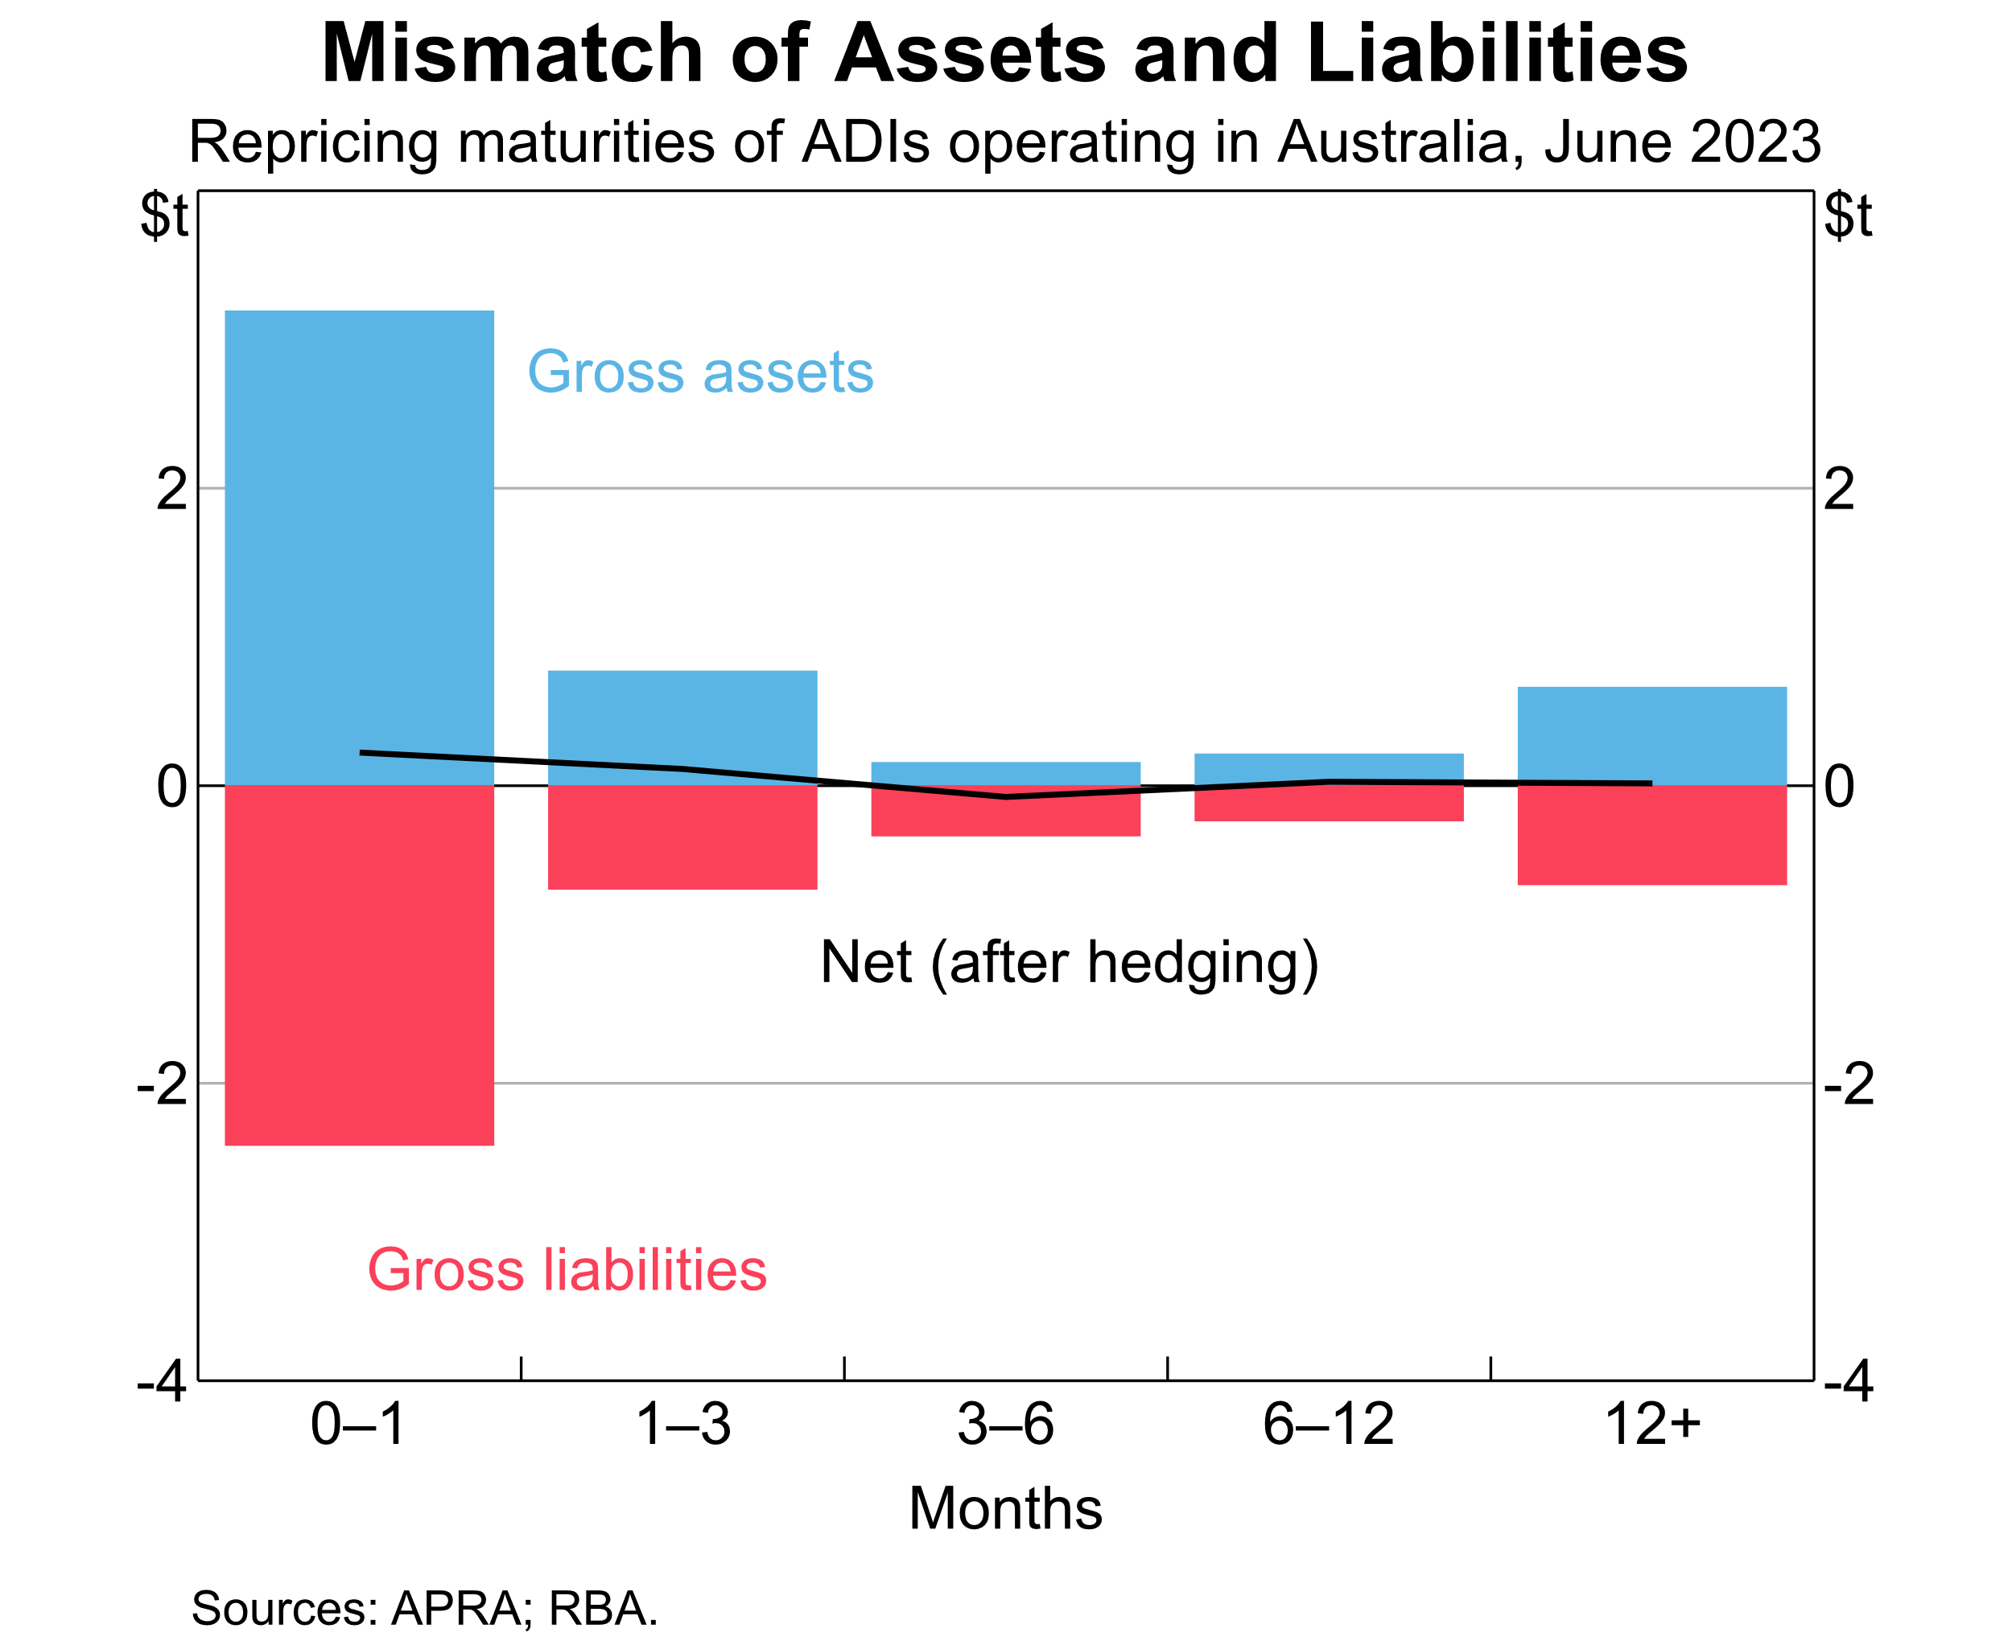

Slide 11
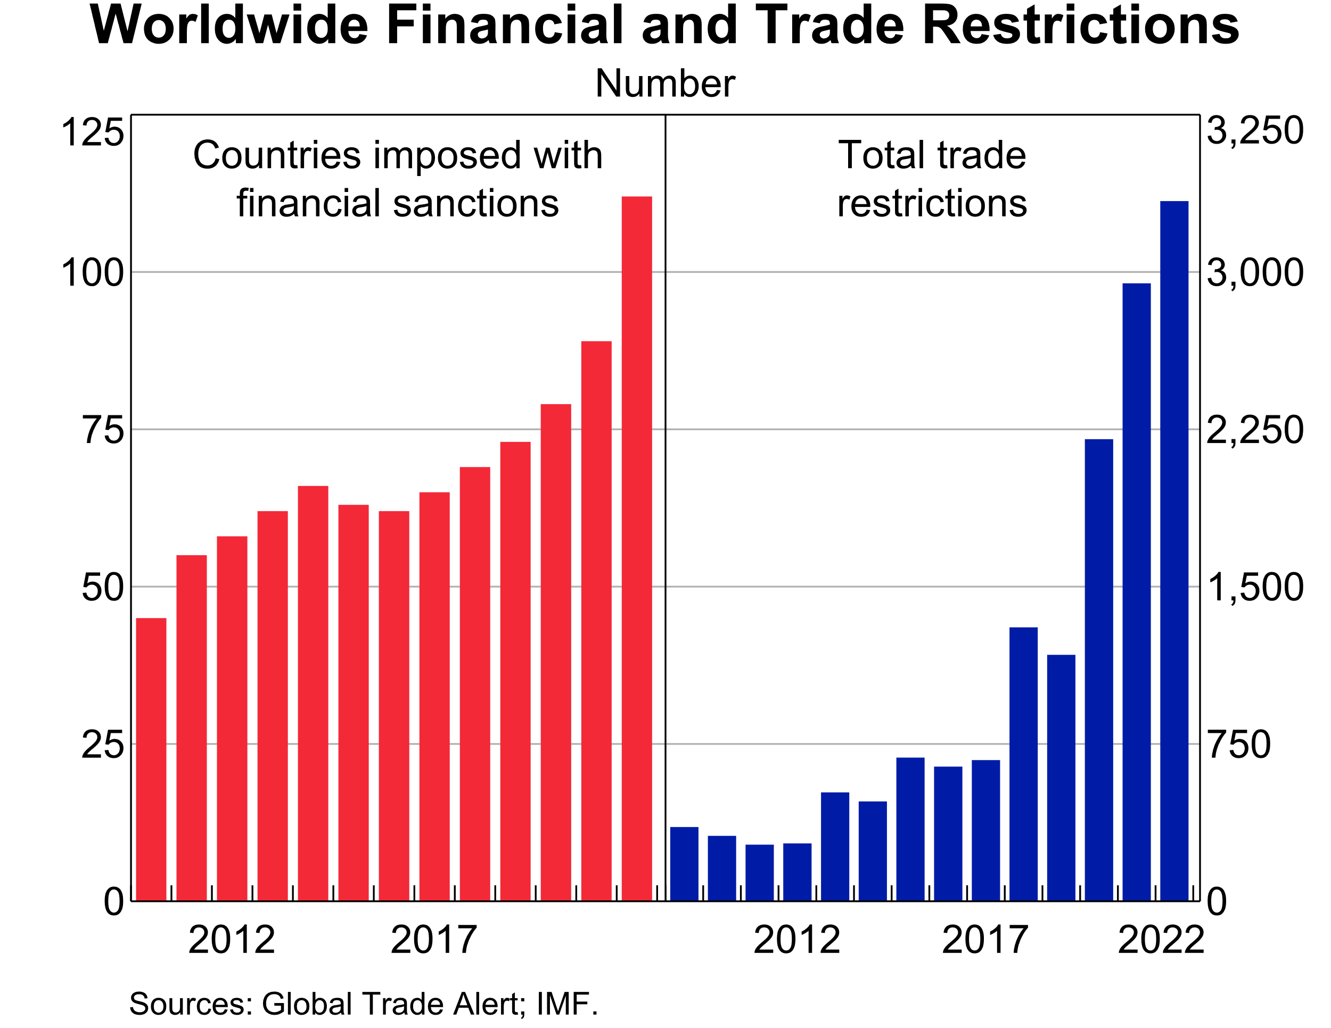

Slide 12
